Slide 1
Lecture No. 14 Metal Finishing
At the end of this lecture, student will be able to:
Explain the theory of electroplating
Describe the components of electroplating
Discuss factors influencing the nature of deposit
Determine the throwing power of a plating bath

Slide 2
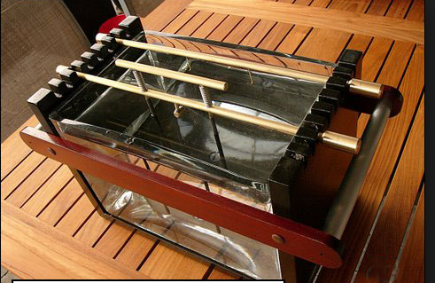
Theory of Electroplating
Metal ions are transferred from a solution and are deposited as a thin layer onto the surface of cathode
Process comprises of an anode and a cathode connected to a DC circuit
Electroplating can enhance;
Chemical properties---increase corrosion resistance
Physical properties---increase thickness of part
Mechanical properties---increase tensile strength & hardness

Slide 3

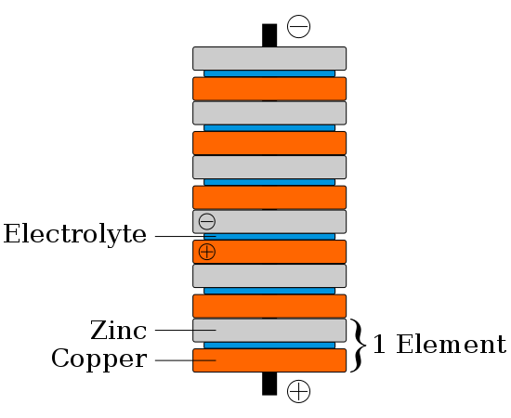
History
1800 A.D. Alessandro Volta created the “voltaic pile”
First galvanic cell - able to produce a steady flow of electrical current
Stack of copper and zinc discs separated by cloth soaked in saline solution (electrolyte)
Wikipedia.org
Notes:
Volta picture from http://www.google.com/imgres?imgurl=http://www.oocities.com/mpennafort/Figuras/volta2.jpg&imgrefurl=http://www.oocities.com/mpennafort/volta.html&usg=__9uMft3
Votaic pile image from:http://en.wikipedia.org/wiki/File:Voltaic_pile.svg

Slide 4
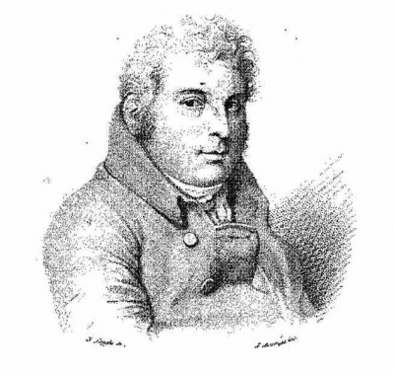

History
Scientists are now able to apply constant current electricity to their experiments
1805, chemist Luigi Brugnatelli - successfully electroplated silver medals with gold
Brugnatelli's inventions were kept secret by the French Academy of Sciences
English and Russian scientists independently discovered the technique 35 years later
Notes:
Image of Luigi: http://www.google.com/imgres?imgurl=http://wikienergia.com/~edp/images/thumb/f/ff/Luigi_Brugnatelli.jpg/400px-Luigi_Brugnatelli.jpg&imgrefurl=http://wikienergia.com/~edp/index.php%3Ftitle%3DLuigi_Valentino_Brugnatelli&usg=__79fqwMMs0XoZLufefBVISLILhl0=&h=379&w=400&sz=59&hl=en&start=0&sig2=Cv3TLoebtrytgIXWlFqIxw&zoom=1&tbnid=O4X6reLVn8K9PM:&tbnh=152&tbnw=160&ei=N3r8TLeHA4PksQOQ5dn3DQ&prev=/images%3Fq%3DLuigi%2BBrugnatelli%26um%3D1%26hl%3Den%26biw%3D1166%26bih%3D602%26tbs%3Disch:1&um=1&itbs=1&iact=rc&dur=429&oei=KXr8TNXVForWtQPbwuD2DQ&esq=6&page=1&ndsp=18&ved=1t:429,r:8,s:0&tx=49&ty=93
Spoon images from: http://www.google.com/imgres?imgurl=http://www.dinendecor.com/catalog/5025.jpg&imgrefurl=http://www.dinendecor.com/servlet/the-685/BAROQUE-92-dsh-Piece-SILVER-PLATED/Detail&usg=__zFM5d104V2FEf7dIvKt0Paxgd4g=&h=300&w=300&sz=19&hl=en&start=69&sig2=Zt9kMVc7qu78-l0tRj_-fA&zoom=1&tbnid=pp8ppvTmQIM6XM:&tbnh=136&tbnw=131&ei=zHr8TPr8MIuosAPmqbH3DQ&prev=/images%3Fq%3Dsilver%2Belectroplated%2Bspoon%26um%3D1%26hl%3Den%26sa%3DN%26biw%3D1166%26bih%3D602%26tbs%3Disch:10,2121&um=1&itbs=1&iact=hc&vpx=434&vpy=213&dur=86&hovh=225&hovw=225&tx=125&ty=137&oei=dXr8TIbiEoOesQPE_Oz3DQ&esq=3&page=5&ndsp=18&ved=1t:429,r:14,s:69&biw=1166&bih=602

Slide 5
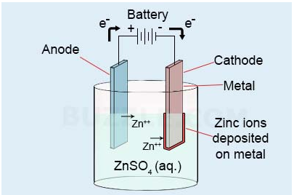
Electroplating:
Process of electrolytic deposition of a metal on the surface of another metal
Substrate may be another metal or alloy or conducting materials in general
Principal components are shown in the following figure.

Slide 6
Components of an Electroplating
Electroplating bath:
Contains a suitable salt solution of the metal being plated
Additives
Anode:
May be a rod or pellets of the metal being plated
May be an inert electrode
Should be electrically conducting
Cathode:
Article to be plated
Should have an electrically conducting surface

Slide 7
Components of an Electroplating
Inert vessel:
Contains above mentioned materials
Vessel may be made of rubber lined steel, plastic, concrete or wood
DC power supply:
Positive terminal of the power supply is connected to the anode
Negative terminal is connected to the cathode

Slide 8
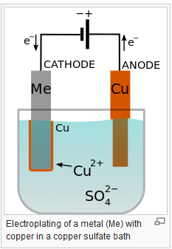

Reaction During Electroplating
Reactions at anode and cathode during electroplating:
Oxidation takes place at anode
When the anode used is an insoluble (inert) anode, oxygen evolution occurs at the anode:
Reduction occurs at cathode
Metal gets deposited on the cathode surface

Slide 9
Characteristics of Good Deposit
Deposit should be:
bright and lustrous
continuous, uniform, non porous and adhesive
hard and ductile
fine grained nature
Factors influencing the nature of electrode deposit:
(i) Current Density
(ii) Plating Bath
(iii) pH
(iv)Temperature
(v) Throwing Power

Slide 10
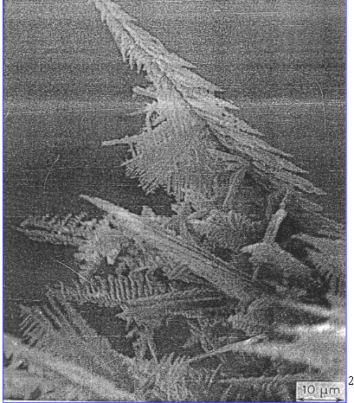
Factors Influencing the Nature of Deposit
Current Density:
An optimum current density should be applied
If low - leads to slow process
- results in coarse grained deposit
If high - leads to rough and treed deposit
- results in burnt and spongy deposit

Slide 11
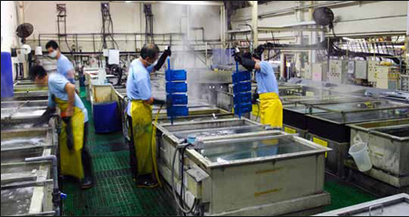
Factors Influencing the Nature of Deposit
Plating bath:
Plating bath contains
Aqueous solution of the electrolyte used for plating
Complexing agent
Buffer to maintain pH
Various organic additives to improve the quality of deposits

Slide 12
Composition of a Plating Bath
Electrolyte concentration:
Optimum electrolyte concentration should be maintained in bath to get a better deposit
Advantages of using a strong solution:
higher conductivity
cathode efficiency
Firm and adherent deposits
Metal ion concentration:
Low metal ion concentrations give adherent coating films
Can be achieved by:
- addition of a compound with a common ion
- formation of complex compounds
Eg: Double cyanides of Na or K

Slide 13
pH of the electrolytic bath
pH of the electrolytic bath:
Suitable pH is maintained using appropriate buffers
In Ni plating, borate buffer is used to maintain pH 4.5
Low pH - more H₂ evolution at cathode surface
High pH - precipitation of hydroxides of metal
Agitation:
Brings up a fresh supply of metal salts to the cathode
Sweeps away gas bubbles to avoid pits
Rapid agitation may
Detach the coated particles
Stir up the sludge
Result in rough and porous deposits

Slide 14
Composition of a Plating Bath
Addition agents:
Additives serve the modification of structure and properties of the electro deposit
Function: Makes the deposit smooth, fine grained, hard and adherent
Types of additives:
Complexing agent:
Eg: Cyanide, sulphamate ions
Brighteners:
Eg: Aromatic sulphonates, thiourea

Slide 15
Composition of a Plating Bath
Wetting Agents : Relieve the gases entrapped
Eg: Sodium lauryl sulphate (CH₃(CH₂)₁₁OSO₃Na)
Levellers: Produce a level deposit by getting adsorbed at places where rapid deposition of metal takes place Eg: Sodium lauryl sulphate
Structure Modifiers:
Additives change the structure of the deposit Eg: Ammonium sulphate

Slide 16
Throwing Power (TP) of a Plating Bath
Used as a measure of the distribution of the deposit
TP is particularly important when the article is of
an irregular shape
Definition
Ability of a plating bath to give a uniform and even deposit on the entire surface of the object, irrespective of its shape is known as throwing power
TP can be improved by:
Separating the distances between the electrodes
Agitating the solution to minimize high local electrolytic resistance

Slide 17
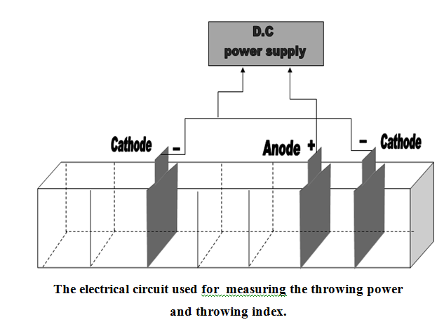

Determination of the Throwing Power of a Plating Bath
The Haring-Blum Cell

Slide 18
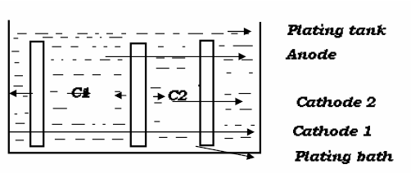
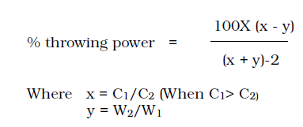
Throwing Power of a Plating Bath
If W1 and W2 is same on both cathodes irrespective to their distance from anode then throwing power is good

Slide 19
Summary
Electroplating: Process comprises of an anode and a cathode connected to a DC circuit
Components of electroplating: Anode, cathode, electrolyte
Factors influencing the nature of deposit: Throwing power, pH, temperature and current density, etc.

